Slide 1








A 2-days National Level Hackathon on
AI in education
Adaptive AI Learning Hub
Team : Battle-Gods
Sourabh Majhee
5 Sep 2025
Pt. Sambhunath Shukla University, Shahdol (M.P)
www.samadhan.sistec.ac.in/

Slide 2

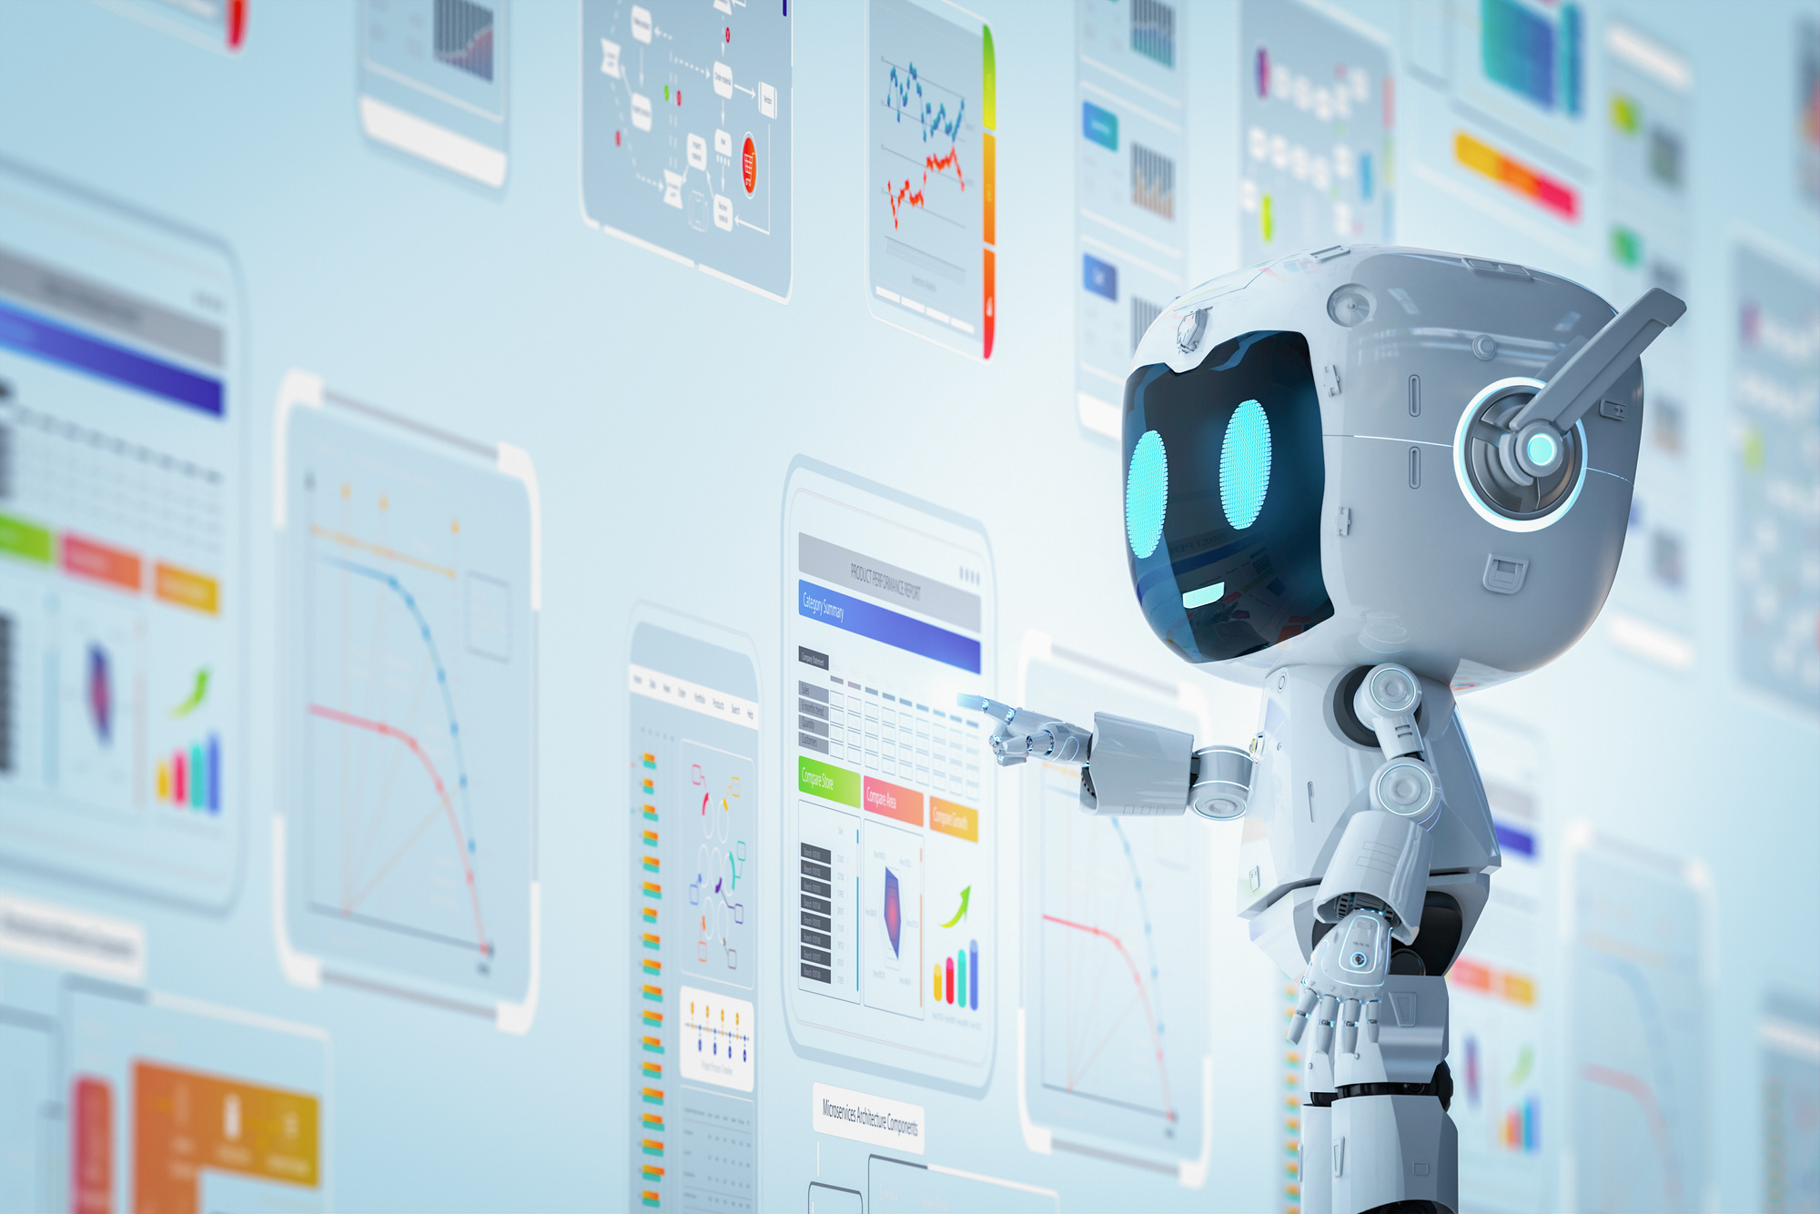
AREA OVERVIEW
Education is rapidly moving online, but students still face challenges like lack of personalized learning, limited teacher availability, and one-size-fits-all content. An AI Learning Hub is a digital platform that adapts to each learner’s needs, providing interactive explanations, quizzes, summaries, and progress tracking—all powered by AI.
IMPORTANCE OF AREA
AI in education transforms how knowledge is delivered and consumed. By integrating adaptive AI systems, we can:
- Provide personalized tutoring for each learner.
- Reduce dependency on limited teacher availability.
- Improve retention and engagement through AI-driven quizzes and gamified learning.
- Ensure scalable, accessible education for students from diverse backgrounds.

Slide 3
Potential Challenges and Opportunities
Challenges:
Lack of personalization in traditional platforms.
Student disengagement in virtual learning.
Limited teacher-to-student ratios in schools.
Opportunities:
Adaptive AI that detects knowledge gaps and adjusts lessons.
24/7 learning assistant for students.
Multilingual support for regional and global accessibility.
Teachers empowered with AI-generated lesson plans and student analytics.

Slide 4
Preliminary Solution Concept
The AI Learning Hub will be a web platform where:
Students input topics or upload notes.
AI generates simplified explanations, quizzes, and visual aids.
The system adapts to performance—identifying weak areas and tailoring content.
A dashboard shows strengths, weaknesses, and progress.
This creates a personal tutor experience for every student

Slide 5
Key Features and Functionalities
Adaptive Learning Engine: Detects weak areas & generates targeted content.
Multi-Mode Explanations: “Explain Like I’m 10”, “Quick Revision”, “College Level”.
Auto Quiz & Flashcard Generator: Dynamic practice based on topics.
Visual Mindmaps & Diagrams: AI converts text into diagrams for better understanding.
Gamified Dashboard: XP points, progress streaks, and personalized roadmaps.
Multilingual Support: Accessibility for students in different regions.

Slide 6
Target Users and Expected Use Cases
Users:
Students (school/college).
Teachers (lesson planning & tracking).
Lifelong learners & professionals.
Use Cases:
A student uploads notes → gets a personalized quiz & study summary.
A teacher enters a topic → gets an instant lesson plan with activities.
A learner revises → AI generates flashcards + mindmaps for quick review.

Slide 7
Data Requirements and Privacy Considerations
Data Needed: User-input text, quiz responses, learning progress.
Data Handling: Stored securely (encrypted databases like Firebase/Supabase).
Privacy: No sharing of personal data; compliance with standard security practices (GDPR-ready).

Slide 8
AI Technologies and Methods
NLP & LLMs (e.g., OpenAI GPT, Hugging Face): Content generation & explanations.
Machine Learning: Adaptive feedback & knowledge gap detection.
Data Visualization Tools (React Flow/D3.js): Interactive mindmaps.
Gamification Logic: AI-driven rewards & motivation strategies.

Slide 9
Implementation Approach
Day 1: Build quiz + explanation engine (frontend + AI API integration).
Day 2: Add progress dashboard + adaptive logic.
Tech Stack: React + Tailwind (frontend), Firebase (backend), OpenAI API / Hugging Face (AI).
Scalability: Can be extended with mobile app & teacher analytics later.

Slide 10
Evaluation Metrics
Learning Effectiveness: % improvement in quiz scores.
Engagement: Avg. time spent per session, streaks maintained.
Adoption: No. of active users/teachers using platform.
Accuracy: AI answer correctness & relevance score.

